Slide 1

Uber Ride Analytics Dashboard
An interactive Power BI solution delivering comprehensive insights into ride performance, revenue optimization, and operational efficiency across bookings, vehicles, customers, and locations.

Slide 2

BUSINESS OBJECTIVE
Understanding the Business Challenge
Performance Visibility
Behavioral Insights
Gain comprehensive visibility into ride performance metrics and revenue trends to identify growth opportunities and operational bottlenecks.
Analyze booking completion versus cancellation patterns to understand customer behavior and reduce revenue loss.
Vehicle Analysis
Customer Behavior
Location Intelligence
Evaluate performance by vehicle type to optimize fleet composition
Understand rider patterns to improve retention and satisfaction
Identify high-demand areas for strategic resource allocation

Slide 3

Dataset Overview: Key Metrics at a Glance
93K
57K
$52M
Completed Bookings
Lost Bookings
Total Revenue
Cancelled or incomplete rides
Aggregate earnings generated
Successfully fulfilled rides
Distance Metrics
Temporal Analysis
2.51M total distance covered across all rides
Comprehensive time-based insights enable trend identification at both monthly and quarterly intervals for strategic planning.
24.64 average distance per ride

Slide 4

DATA PREPARATION
Data Cleaning & Transformation Process
01
02
03
Standardization
Deduplication
Segmentation
Cleaned and standardized booking, customer, vehicle, and payment data for consistency across all dimensions
Removed duplicate records to ensure accuracy in KPI calculations and prevent inflated metrics
Handled incomplete and cancelled ride records separately to enable detailed loss analysis
04
05
Temporal Hierarchy
Validation
Created comprehensive date hierarchies enabling monthly and quarterly trend analysis
Ensured numeric consistency across revenue, distance, and booking count fields

Slide 5


Data Modeling Architecture
Star Schema Design
DAX Calculations
Implemented efficient star-schema model connecting core dimensions:
Developed strategic calculated measures for actionable insights:
Booking Metrics
Financial Measures
Bookings (fact table)
Customers
Completed and lost booking counts with dynamic filtering
Total revenue and average revenue per ride calculations
Vehicles
Payment Methods
Distance Analytics
Calendar (date dimension)
Total and average distance measures for efficiency tracking
Interactive slicers enable month and quarter filtering for flexible temporal analysis

Slide 6





Dashboard Structure & Key Performance Indicators
Overview Page
Centralized view of all critical KPIs including 93K completed bookings, 57K lost bookings, $52M revenue, 2.51M total distance, and 24.64 average distance per ride
Vehicle Analysis
Deep dive into vehicle type performance, utilization rates, and revenue contribution by category
Revenue Intelligence
Financial performance breakdown by payment method, time period, and booking status
Rider Insights
Customer segmentation, behavior patterns, and satisfaction metrics across rider categories
Location Analytics
Geographic performance analysis identifying high-demand zones and operational hotspots

Slide 7
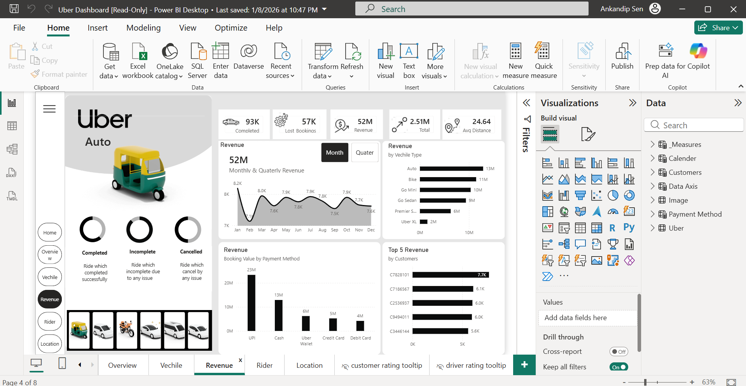

Slide 8

KEY INSIGHTS
Bookings & Revenue Performance Analysis
Consistent Booking Volume
Monthly completed bookings demonstrate stability, ranging between 7K–8K per month, indicating steady demand and reliable service delivery.
Vehicle Revenue Leaders
Auto and Bike categories generate the highest revenue streams, representing critical segments for business optimization and fleet investment.
Revenue Distribution
Payment Preferences
Analysis reveals clear concentration in specific vehicle categories, with Auto and Bike commanding dominant market share. This concentration presents both opportunity and risk for portfolio diversification.
UPI and Cash emerge as the most utilized payment methods by total booking value, reflecting customer payment behavior and digital adoption trends.

Slide 9
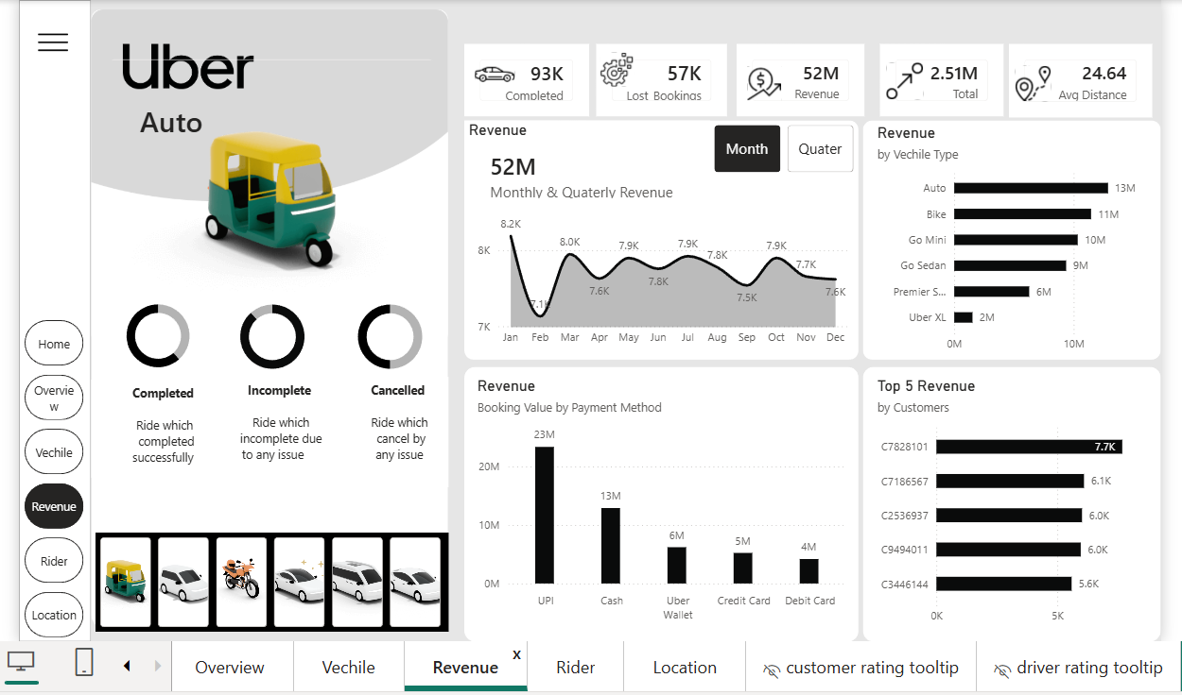

Slide 10



Customer & Location Intelligence
104K
4.40
4.23
Total Customers
Customer Rating
Driver Rating
Observed across entire dataset
Average satisfaction score
Average service quality score
Rider Segmentation
High-Demand Locations
Customer base stratifies into three distinct categories:
Geographic analysis identifies key hotspots with Khandsa and Ashram leading in booking volume, presenting opportunities for targeted resource allocation.
First-time riders: New user acquisition
Return riders: Occasional repeat customers
Regular riders: High-frequency loyal customers

Slide 11
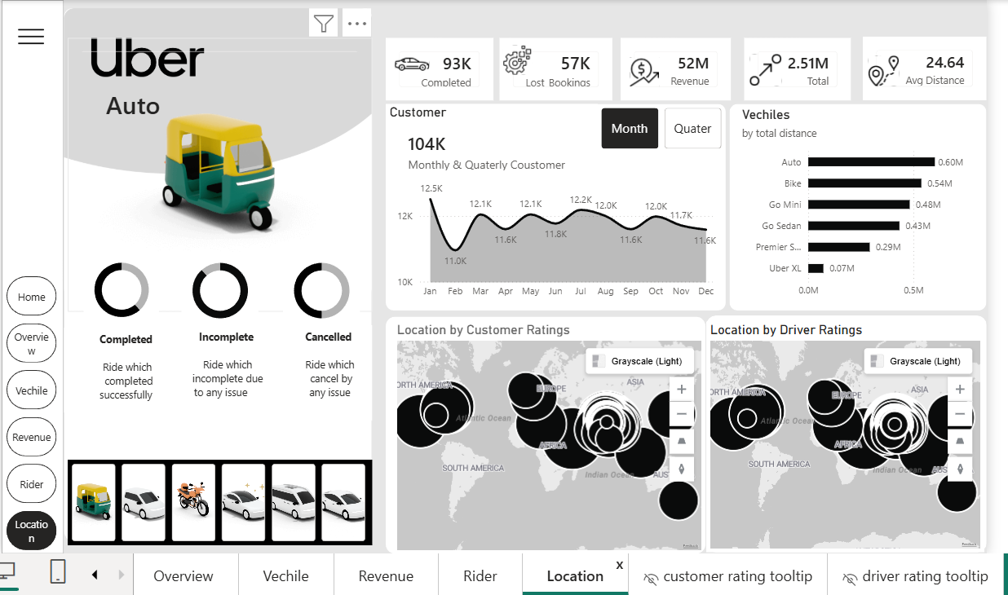

Slide 12





ACTIONABLE INSIGHTS
Business Impact & Strategic Recommendations
Optimize Fleet Mix
Reduce Lost Bookings
Prioritize operational resources on high-revenue vehicle types (Auto and Bike) to maximize profitability and service quality
Analyze cancellation and incomplete ride patterns to implement targeted interventions and recover 57K in lost opportunities
Accelerate Digital Adoption
Strategic Deployment
Promote UPI and digital payment methods to improve transaction efficiency, reduce cash handling costs, and enhance user experience
Leverage location insights to optimize driver availability in high-demand areas, reducing wait times and improving service coverage

Slide 13

Conclusion & Future Roadmap
Project Summary
Future Enhancements
This Power BI dashboard delivers a comprehensive, end-to-end view of Uber ride performance, transforming raw data into actionable intelligence that enables faster, data-driven business decisions across all operational levels.
1
Cancellation Deep Dive
Implement detailed cancellation reason taxonomy and root cause analysis
2
Temporal Demand Patterns
Develop time-of-day and day-of-week demand forecasting models
3
Driver Performance
Create comprehensive driver benchmarking and performance scorecards
4
Predictive Analytics
Build ML-powered demand forecasting for proactive resource planning

